Slide 1
Section 3.1
Functions
Copyright © 2012 Pearson Education, Inc. Publishing as Prentice Hall.

Slide 2
Copyright © 2012 Pearson Education, Inc. Publishing as Prentice Hall.

Slide 3
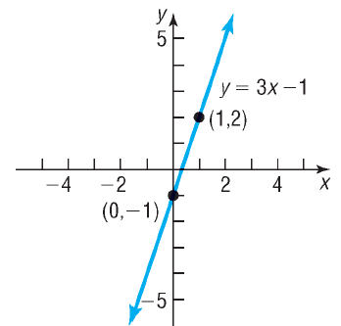
A relation is a correspondence between two sets.
If x and y are two elements in these sets and if a relation exists between x and y, then we say that x corresponds to y or that y depends on x, and we write x → y.
Copyright © 2012 Pearson Education, Inc. Publishing as Prentice Hall.

Slide 4

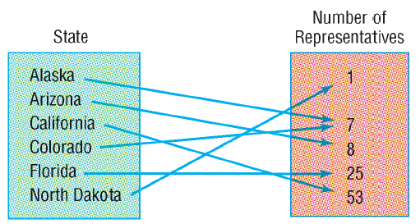
Copyright © 2012 Pearson Education, Inc. Publishing as Prentice Hall.

Slide 5
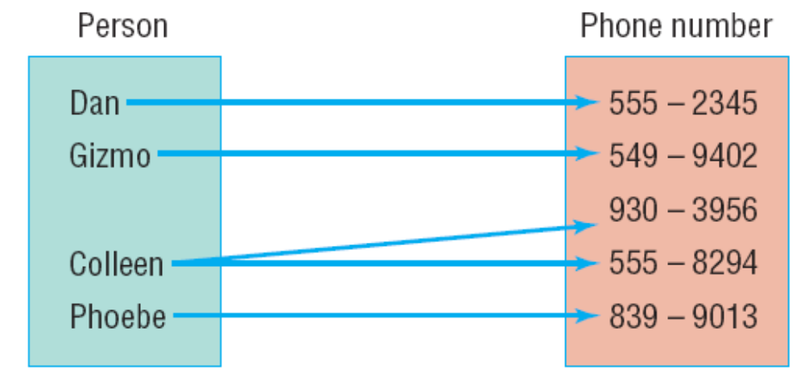
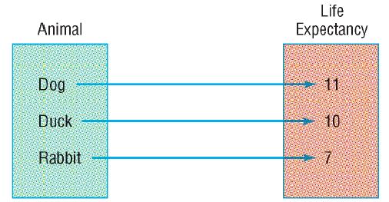
FUNCTION
Copyright © 2012 Pearson Education, Inc. Publishing as Prentice Hall.

Slide 6

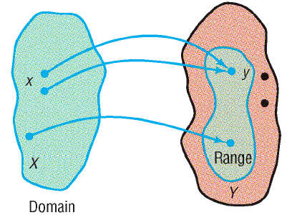
Copyright © 2012 Pearson Education, Inc. Publishing as Prentice Hall.

Slide 7
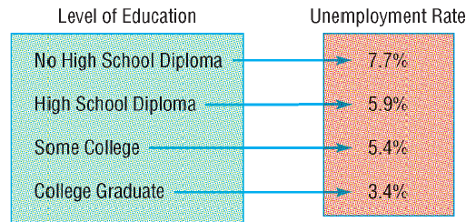
Determine if the following relations represent functions. If the relation is a function, then state its domain and range.
Yes, it is a function. The domain is {No High School Diploma, High School Diploma, Some College, College Graduate}. The range is {3.4%, 5.4%, 5.9%, 7.7%}.
Copyright © 2012 Pearson Education, Inc. Publishing as Prentice Hall.

Slide 8
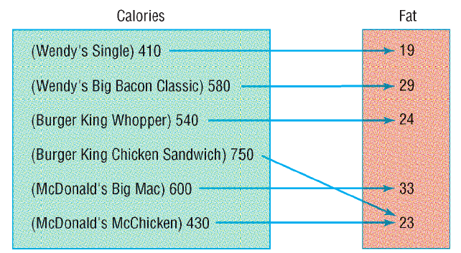
Yes, it is a function. The domain is {410, 430, 540, 580, 600, 750}. The range is {19, 23, 24, 29, 33}. Note that it is okay for more than one element in the domain to correspond to the same element in the range.
Copyright © 2012 Pearson Education, Inc. Publishing as Prentice Hall.

Slide 9
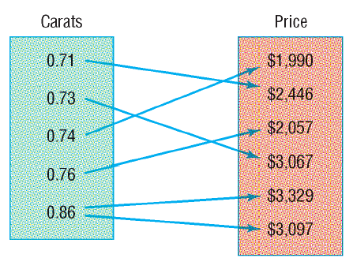
No, not a function. Each element in the domain does not correspond to exactly one element in the range (0.86 has two prices assigned to it).
Copyright © 2012 Pearson Education, Inc. Publishing as Prentice Hall.

Slide 10
Determine whether each relation represents a function. If it is a function, state the domain and range.
a) {(2, 3), (4, 1), (3, –2), (2, –1)}
No, it is not a function. The element 2 is assigned to both 3 and –1.
b) {(–2, 3), (4, 1), (3, –2), (2, –1)}
Yes, it is a function because no ordered pairs have the same first element and different second elements.
c) {(4, 3), (3, 3), (4, –3), (2, 1)}
No, it is not a function. The element 4 is assigned to both 3 and –3.
Copyright © 2012 Pearson Education, Inc. Publishing as Prentice Hall.

Slide 11
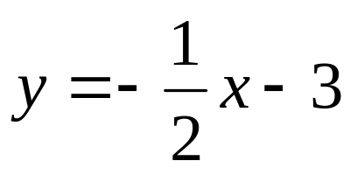
Determine if the equation defines y as a function of x.
Yes, this is a function since for any input x, when you multiply by –1/2 and then subtract 3, you would only get one output y.
Copyright © 2012 Pearson Education, Inc. Publishing as Prentice Hall.

Slide 12
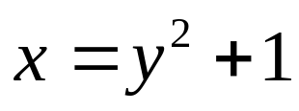
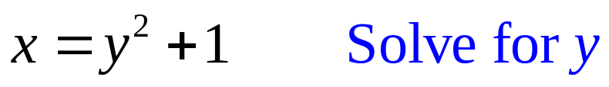
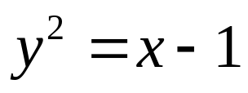
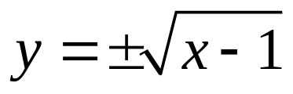
Determine if the equation defines y as a function of x.
No, this it not a function since for values of x greater than 1, you would have two outputs for y.
Copyright © 2012 Pearson Education, Inc. Publishing as Prentice Hall.

Slide 13
Copyright © 2012 Pearson Education, Inc. Publishing as Prentice Hall.

Slide 14
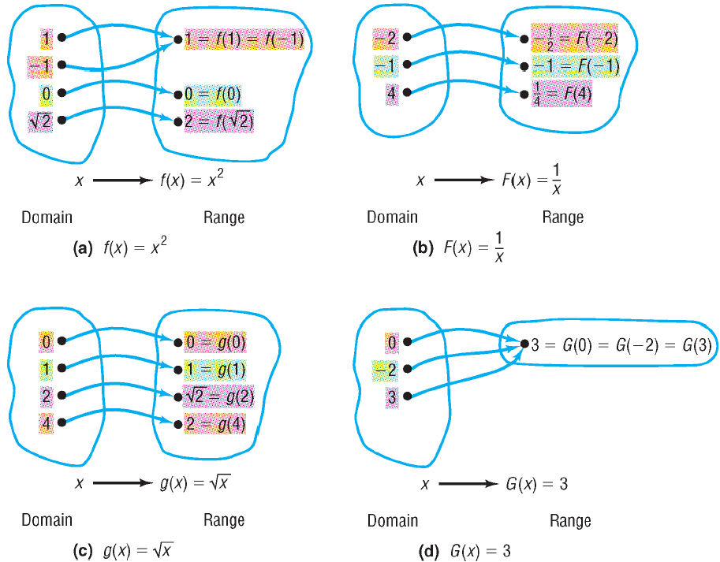
Copyright © 2012 Pearson Education, Inc. Publishing as Prentice Hall.

Slide 15
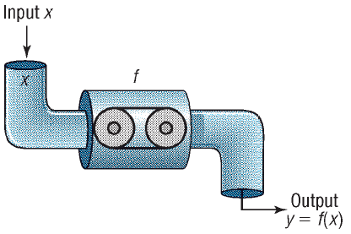
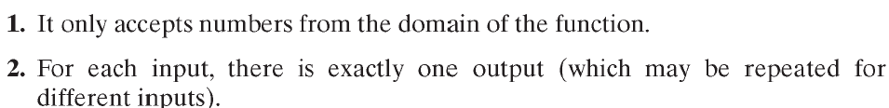
FUNCTION MACHINE
Copyright © 2012 Pearson Education, Inc. Publishing as Prentice Hall.

Slide 16
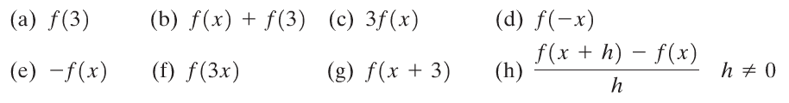
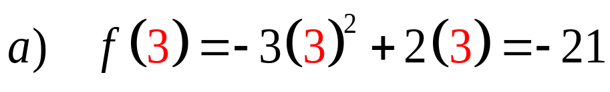
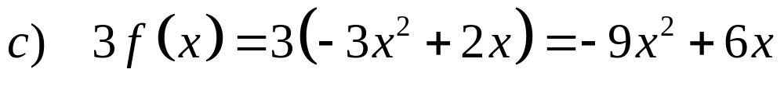
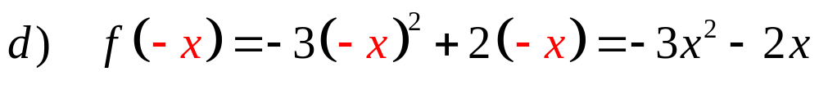
Copyright © 2012 Pearson Education, Inc. Publishing as Prentice Hall.

Slide 17
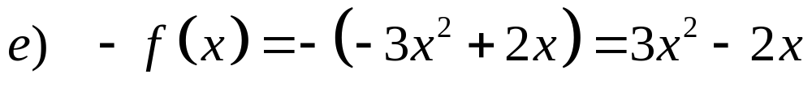
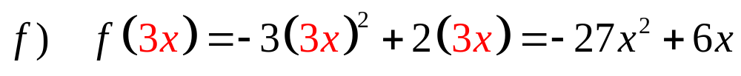

Copyright © 2012 Pearson Education, Inc. Publishing as Prentice Hall.

Slide 18
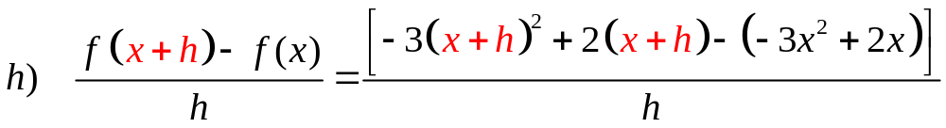
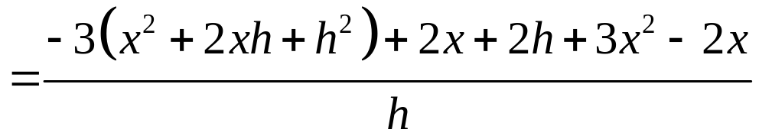
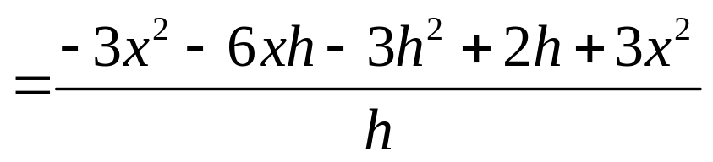
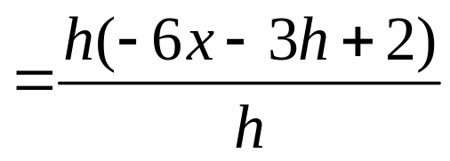

Copyright © 2012 Pearson Education, Inc. Publishing as Prentice Hall.

Slide 19




Copyright © 2012 Pearson Education, Inc. Publishing as Prentice Hall.

Slide 20

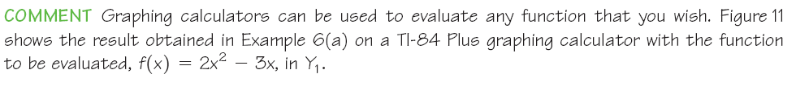
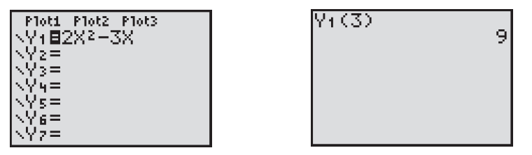
Graphing calculators can be used to evaluate any function that you wish
Figure below shows the result obtained on a TI-84 graphing calculator with
The function to be evaluated,
Copyright © 2012 Pearson Education, Inc. Publishing as Prentice Hall.

Slide 21
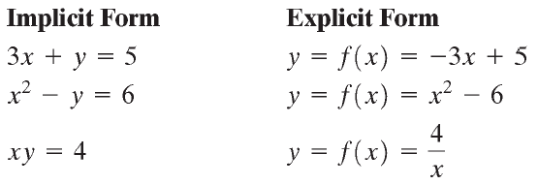
Copyright © 2012 Pearson Education, Inc. Publishing as Prentice Hall.

Slide 22
Summary
Important Facts About Functions
For each x in the domain of f, there is exactly one image f(x) in the range; however, an element in the range can result from more than one x in the domain.
f is the symbol that we use to denote the function. It is symbolic of the equation that we use to get from an x in the domain to f(x) in the range.
If y = f(x), then x is called the independent variable or argument of f, and y is called the dependent variable or the value of f at x.
Copyright © 2012 Pearson Education, Inc. Publishing as Prentice Hall.

Slide 23
Copyright © 2012 Pearson Education, Inc. Publishing as Prentice Hall.

Slide 24
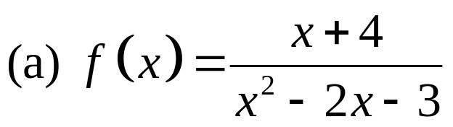
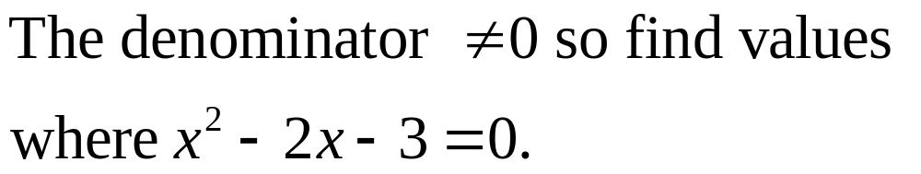
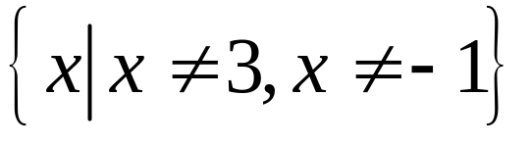
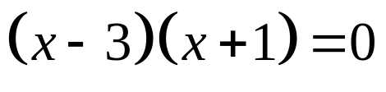
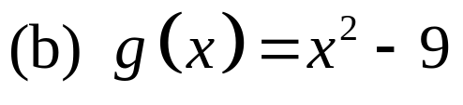

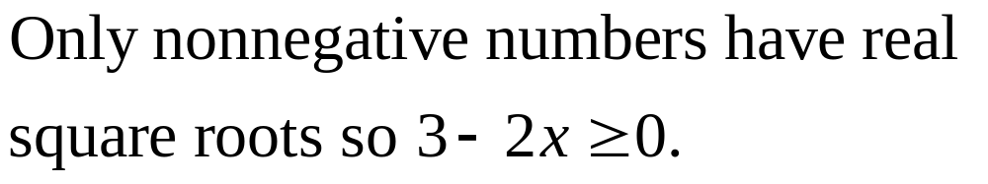
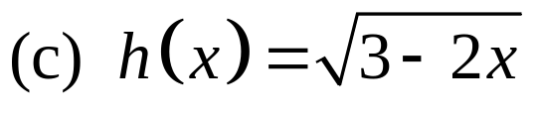
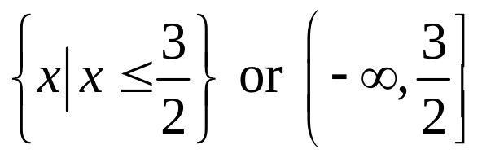
Copyright © 2012 Pearson Education, Inc. Publishing as Prentice Hall.

Slide 25
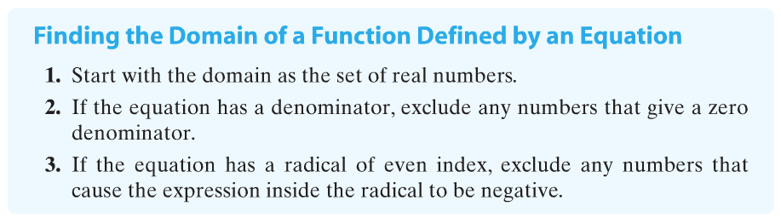
Copyright © 2012 Pearson Education, Inc. Publishing as Prentice Hall.

Slide 26
A rectangular garden has a perimeter of 100 feet. Express the area A of the garden as a function of the width w. Find the domain.
A
w
A(w) = w(50 – w )
Domain: 0 < w < 50
Copyright © 2012 Pearson Education, Inc. Publishing as Prentice Hall.

Slide 27

Copyright © 2012 Pearson Education, Inc. Publishing as Prentice Hall.

Slide 28
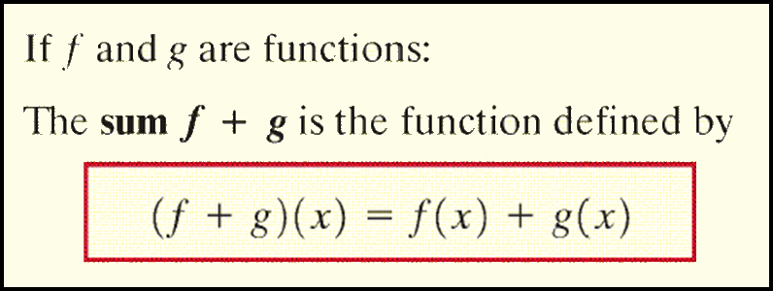
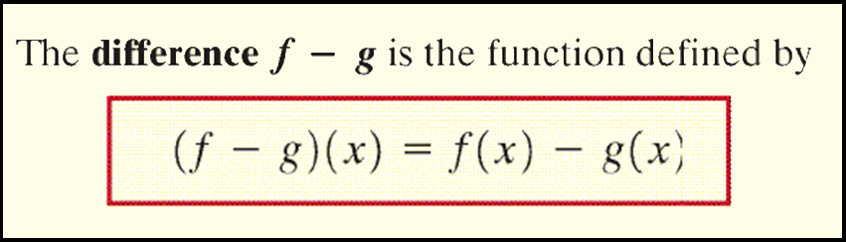
Copyright © 2012 Pearson Education, Inc. Publishing as Prentice Hall.

Slide 29
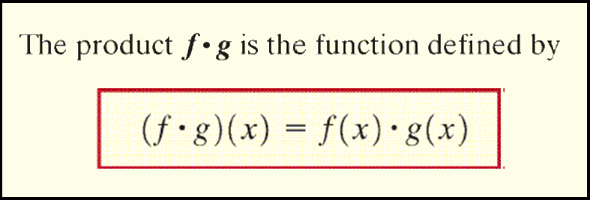
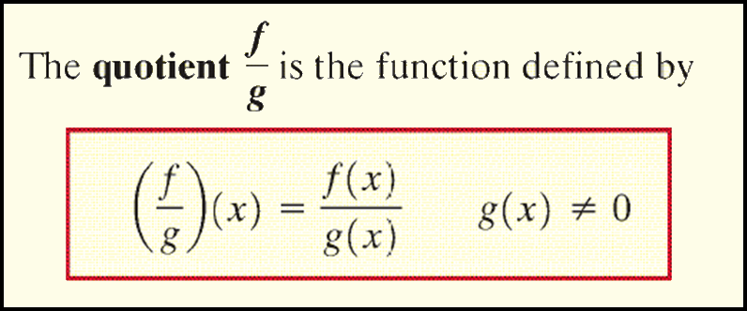
Copyright © 2012 Pearson Education, Inc. Publishing as Prentice Hall.

Slide 30

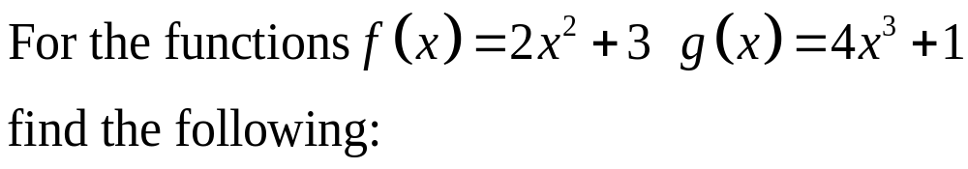

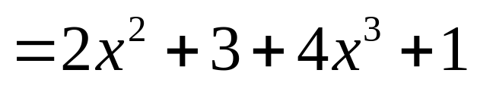
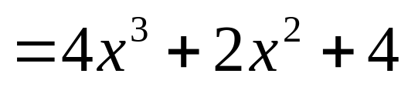

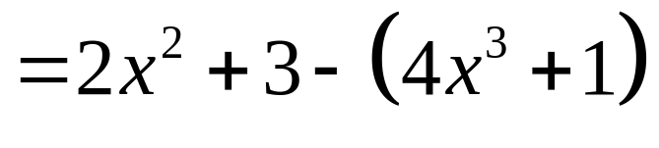
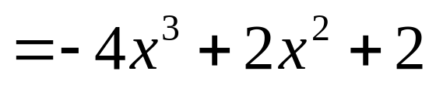

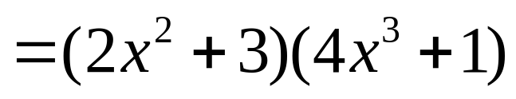
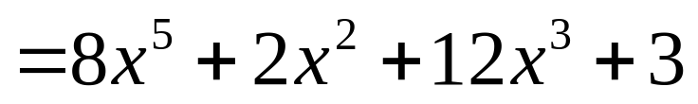

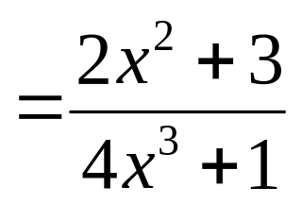
Copyright © 2012 Pearson Education, Inc. Publishing as Prentice Hall.

Slide 31

Copyright © 2012 Pearson Education, Inc. Publishing as Prentice Hall.

